Slide 1
Lecture 2a Some Functions

Slide 2
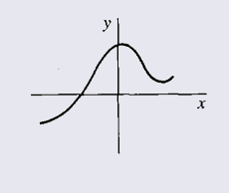
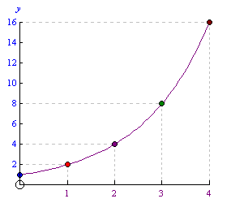
Real-Valued Functions of a Real Variable
f: R → R
y = f(x)
in Algorithm Analysis t = g(n)
f: N → R⁺
^{non-decreasing}
^{discrete graph}

Slide 3
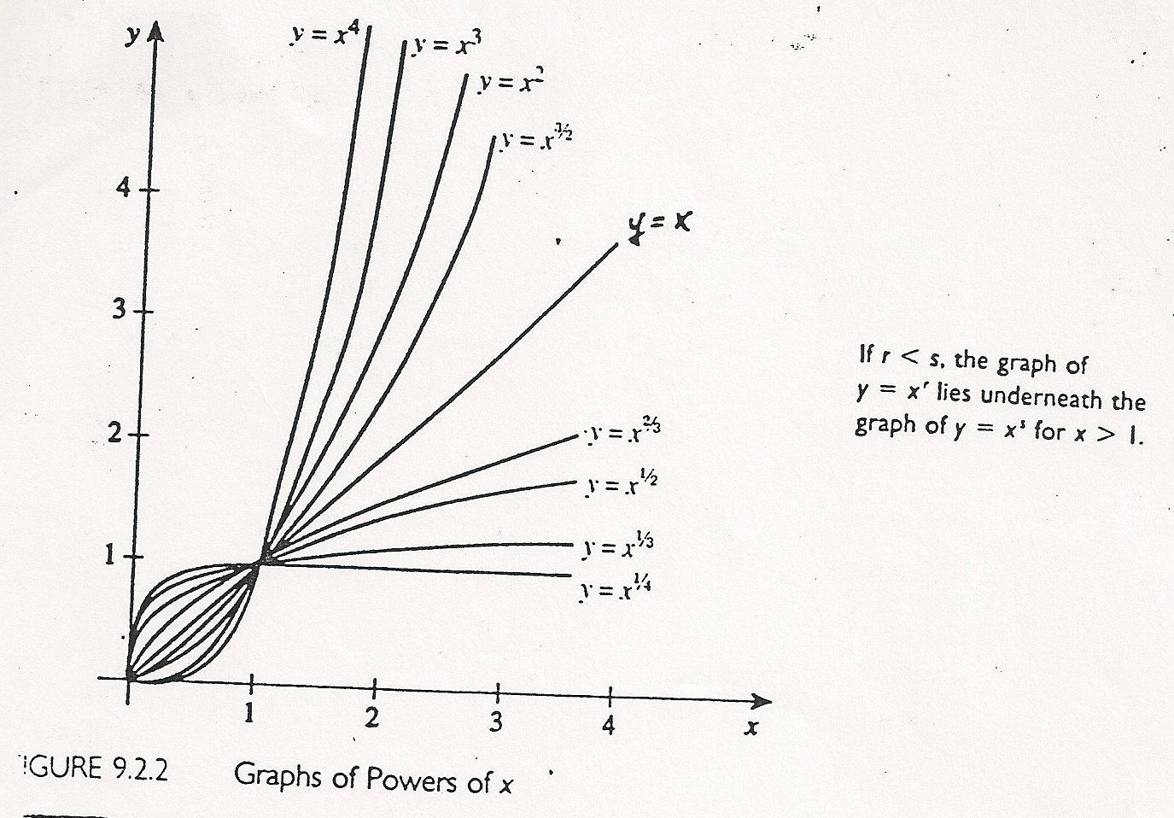
Power Functions
(the cubic function)
y = xª , a≥0
a - exponent
(the quadratic function)
(the linear function)
y = x⁰ = 1
(the constant function)

Slide 4
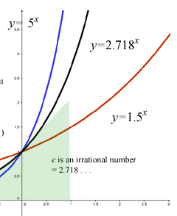
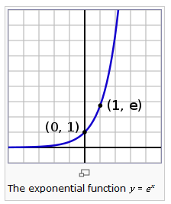
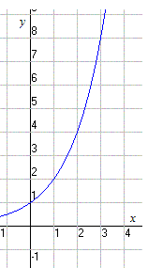

The Exponential Function
=e^{x}
y = b^{x} , b>1 b - base
y=2^{x}
y=2^{x}

Slide 5
y = xª power function
y = a^{x} exponential function

Slide 6
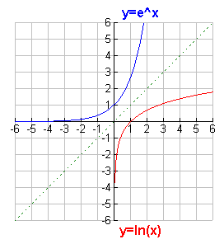
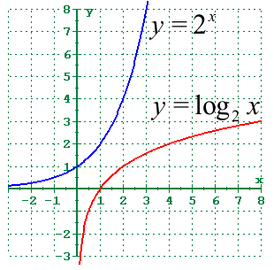
The Logarithmic Function
y = log_{b}x ≡ b^{y} = x

Slide 7
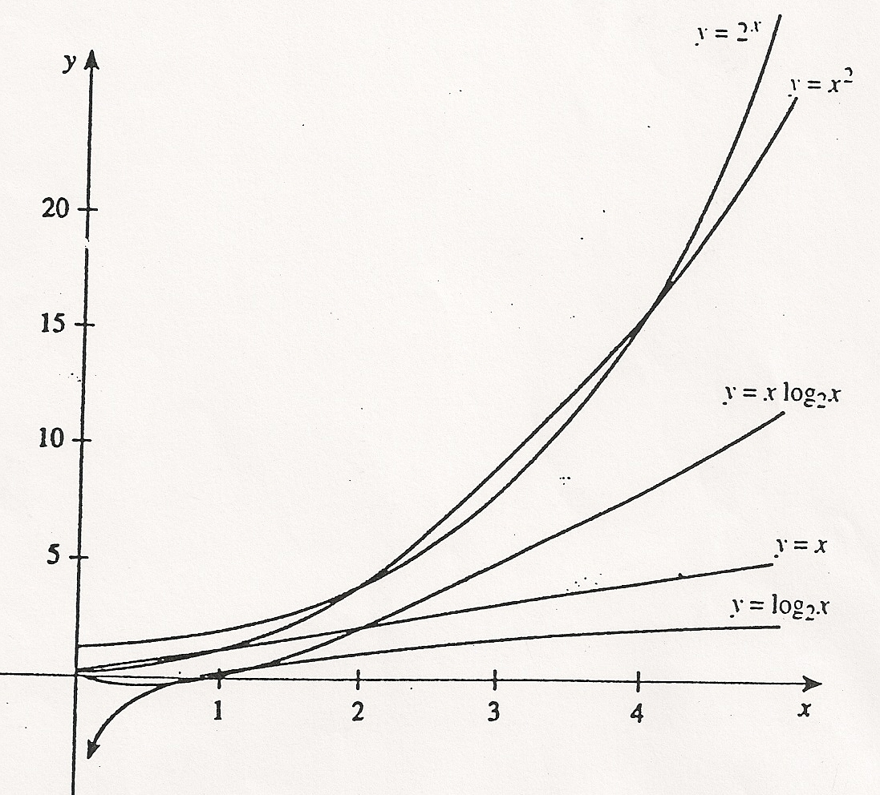
Comparison of Functions

Slide 8

Comparison of Functions
linearithmic function
1
Important for large enough x!

Slide 9
Typical Growth Rates (Most Common Efficiency Functions)
linearithmic f.

Slide 10
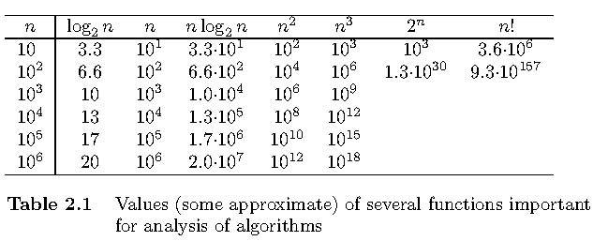
Comparison of Functions

Slide 11
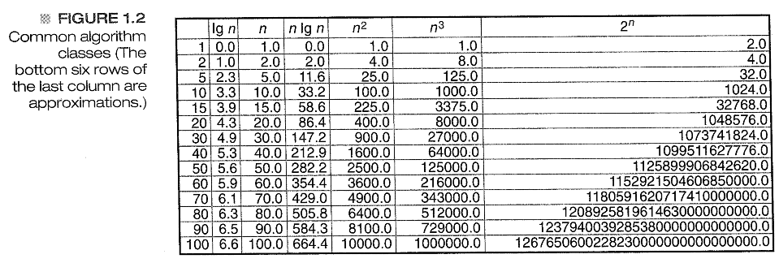
Comparison of Functions

Slide 12
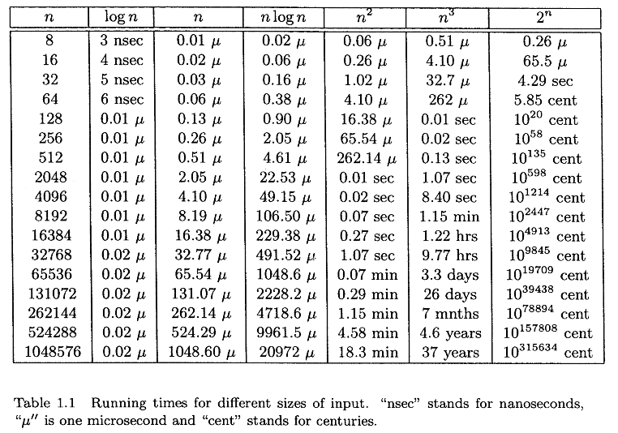
Assume the function represents the number of operations executed and one operation takes 1 ns

